Slide 1
RETAIL DATA ANALYSIS AND INSIGHTS
BY -
Prabhjot SINGH

Slide 2
AGENDA
Data Overview
Data Inspection
Data Handling and Data Cleaning
EDA - High Level Metrics
Customer Behaviour
Sales Trends
Store & Product Analysis
Insights
Recommendations

Slide 3
INTRODUCTION
Aim : To analyse sales and customers behaviour to provide actionable insights.
Objectives : Improve sales, enhance customer acquisition and customer retention strategies.

Slide 4
DATA OVERVIEW
Data Sources :
Customers, Orders, Payments, Products, Ratings, Stores
Data Structure :
Customers – Rows : 99441, Columns : 4
Orders – Rows : 112650, Columns : 11
Payments – Rows : 102460, Columns : 3
Products – Rows : 32951, Columns : 9
Stores – Rows : 534, Columns : 3
Ratings – Rows : 98874, Columns : 2

Slide 5
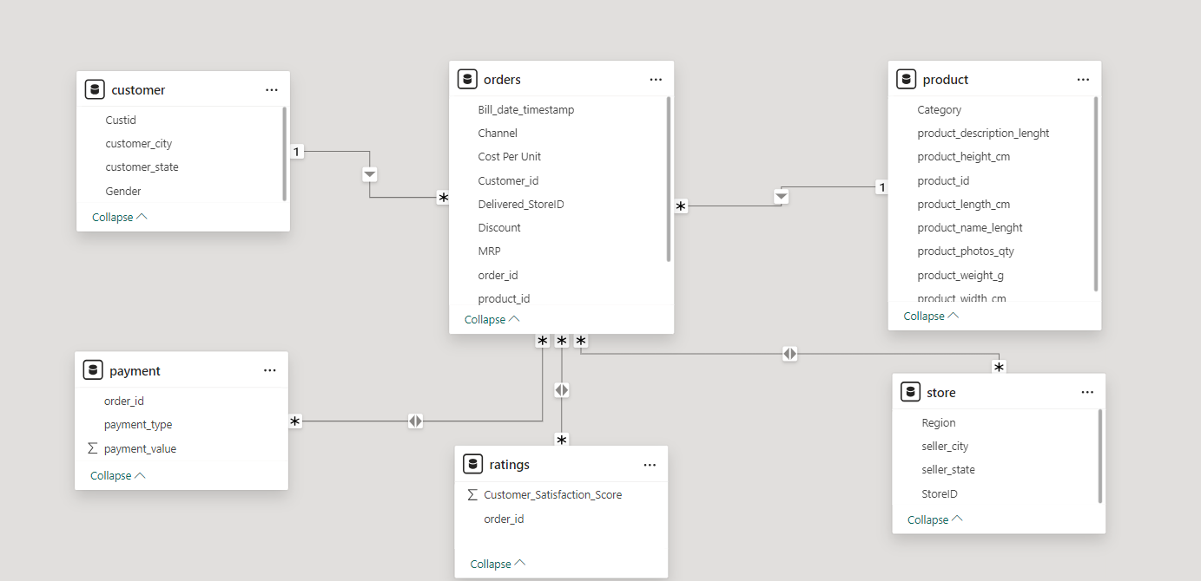
DATA MODELLING

Slide 6
DATA INSPECTION
Duplicate and Missing values
Date format inconsistency
Payment amount and Total Amount problem
One order having multiple stores
Multiple customers having same order
One Product category is not defined
Orders present in payment but not in orders table

Slide 7
DATA CLEANING
Handling missing values and duplicates by removing the records.
Replacing the quantity by 1 for such orders where the payment value and sales amount is not same.
Replacing the stores with the first occurring store where multiple store mapped to one order.
For the customers having same orders, deleting the record of one customer.

Slide 8
DATA CLEANING
Updated not defined category of #NA to unknown category in product table.
Deleted the order which are present in payment.
but not present in orders table.
Total amount column updated as (Quantity *MRP) – Discount.

Slide 9
EXPLORATORY DATA ANALYSIS – HIGH LEVEL METRICS
Number of Orders : 98,666
Number of Customers : 98,575
Total Discount : 5.52 lakhs
Total Sales : 1.59 Cr
Total Profit : 22.51 lakhs
Total Quantity : 1,12,500
Average sales per customer : Rs 161
Average profit per customer : Rs 23
Average discount per customer : Rs 5

Slide 10
ANALYSIS ON HIGH LEVEL METRICS
The repeat purchase rate is 0.1 % and the repeat customer percentage is 0.04 % while the one time buyers percentage is 99.96 %. highlighting for improving customer retention strategies.
The average sales per customer is Rs 161, showing that each customer contributes significantly to the overall sales.

Slide 11
ANALYSIS ON HIGH LEVEL METRICS
The average profit per customer is Rs 23 and the overall percentage of profit on total sales is 22.8 % . This indicates that despite the low retention rate, the business is maintaining a good profit margins.
There are 32,951 unique products across 14 categories, suggesting a diverse product offerings.

Slide 12
CUSTOMER ANALYSIS – SEGMENTATION

Slide 13
CUSTOMER BEHAVIOUR ANALYSIS

Slide 14
CUSTOMER ANALYSIS
Customer Preferences:
Preferred Channel : INSTORE - 86 % customers
Preferred Payment Method :
CREDIT CARD – 76 % customers
Preferred Store : ST103 – 26 % customers
Preferred Category : TOYS & GIFTS – 15 % customers

Slide 15

CUSTOMER ANALYSIS
Behaviour of One-Time vs Repeat Buyers:
One time buyers contribute 99.89 % of the total sales comparing the repeated buyers to only 0.11 %.
The average quantity per order for both type of buyers is 1.10

Slide 16
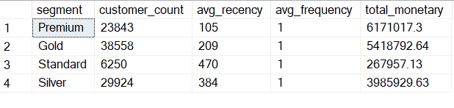
RFM SEGMENTATION

Slide 17
SALES ANALYSIS – TRENDS

Slide 18
SALES ANALYSIS – TRENDS

Slide 19
SALES ANALYSIS – WEEK DAYS SALES

Slide 20
SALES ANALYSIS – TRENDS
The sales are higher on weekdays, especially mid-week compared to weekends. This could indicate that customers are more likely to make purchases during the working days.
The sales peak on Wednesday, contributing 27 % of the overall sales.
August 2023 had the highest sale of 12.6 lakhs , contributing approx. 8% of the total sales.

Slide 21
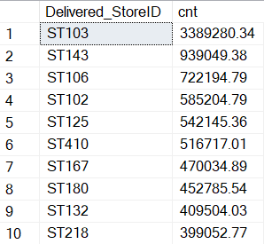
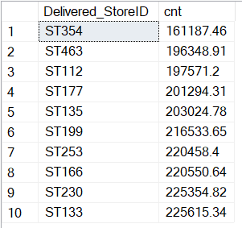
STORE PERFORMANCE
Top 10 stores by sales: Worst 10 stores by sales:

Slide 22
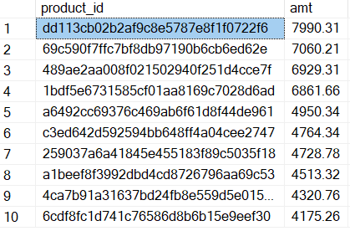
PRODUCT ANALYSIS
Top 10 most expensive products:

Slide 23
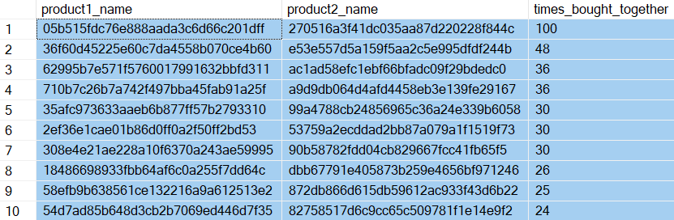
CROSS PRODUCT ANALYSIS
Top 10 combinations of products most bought:

Slide 24
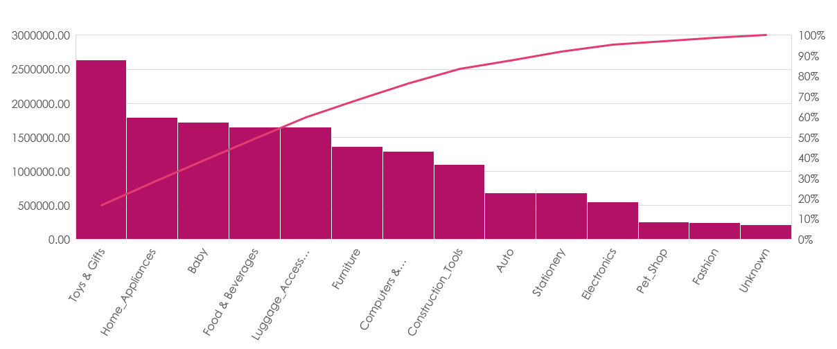
PARETO ANALYSIS

Slide 25
PARETO ANALYSIS
Insight:
Toys and gift is the highest selling category, contributing 20 % to the total sales.
Home Appliances, Baby, Food & Beverages are other top performing categories, each contributing a substantial portion to the total sales.
The top 4 categories together account for 50 % of the total sales.
Categories like Electronics, Pet Shop, Fashion contributes least to the total sales.

Slide 26
RECOMMENDATIONS
Implement registration programs :
Introduce free registrations programs that provides special rewards for the customers that orders after registering, which gives repeated purchases and long term engagement.
Offer special benefits, discounts and early access to new products for registered customers to foster a deeper connection and encourage continuous shopping.
Marketing Strategies:
Develop marketing campaigns specifically aimed to one time buyers improving the low retention rate.

Slide 27
RECOMMENDATIONS
Enhancing Products and service Offerings:
Regularly collect feedback from customers to understand their needs and expectations.
Use this feedback to enhance product quality and service offerings.
Optimizing Sales Channels :
Providing a seamless online shopping experience allowing customers to make purchases at any time, increasing sales and trust towards the company.

Slide 28
THANK YOU
Q & A

